Slide 1
3. Probabilistic Reasoning
Introduction to Artificial Intelligent (AI)

Slide 2
Probabilistic Reasoning
Real world is filled with uncertainty and ambiguity
- unreliable source of information
- equipment faults/errors
- temperature variation …
Probabilistic reasoning is making decisions based on probabilities and likelihoods rather than absolute facts.
Probabilistic reasoning provides a mathematical framework for dealing with uncertainty and making rational decisions

Slide 3
Review of Probability

Slide 4
Review of Probability
Random variable
Joint and Marginal Distributions
Conditional distribution
Product Rule, chain rule, Bayes’ Rule
Inference
Independence

Slide 5


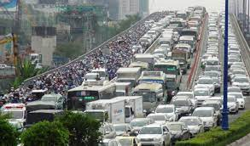
Review of Probability
A random variable represents an event whose outcome is unknown
A probability distribution is an assignment of weight to outcomes
Example: traffic on freeway
  Random variable: T = whether there’s traffic
  Outcomes: T in {none, light, heavy}
  Distribution: P(T=none) = 0.25,
  P(T=light) = 0.5,
  P(T=heavy) = 0.25
0.25
0.5
0.25

Slide 6
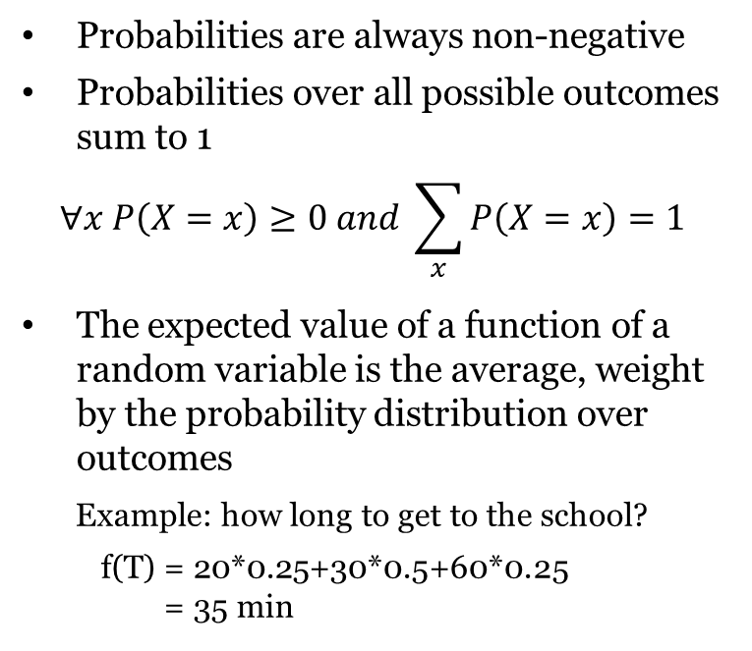
Review of Probability
P(T)
Time
Probabilities are always non-negative
Probabilities over all possible outcomes sum to 1
$$∀x P\left(X=x\right)≥0 and \sum_{x}{P\left(X=x\right)=1}$$
The expected value of a function of a random variable is the average, weight by the probability distribution over outcomes
Example: how long to get to the school?
f(T) = 20*0.25+30*0.5+60*0.25
= 35 min
0.25
20’
0.5
30’
0.25
60’

Slide 7
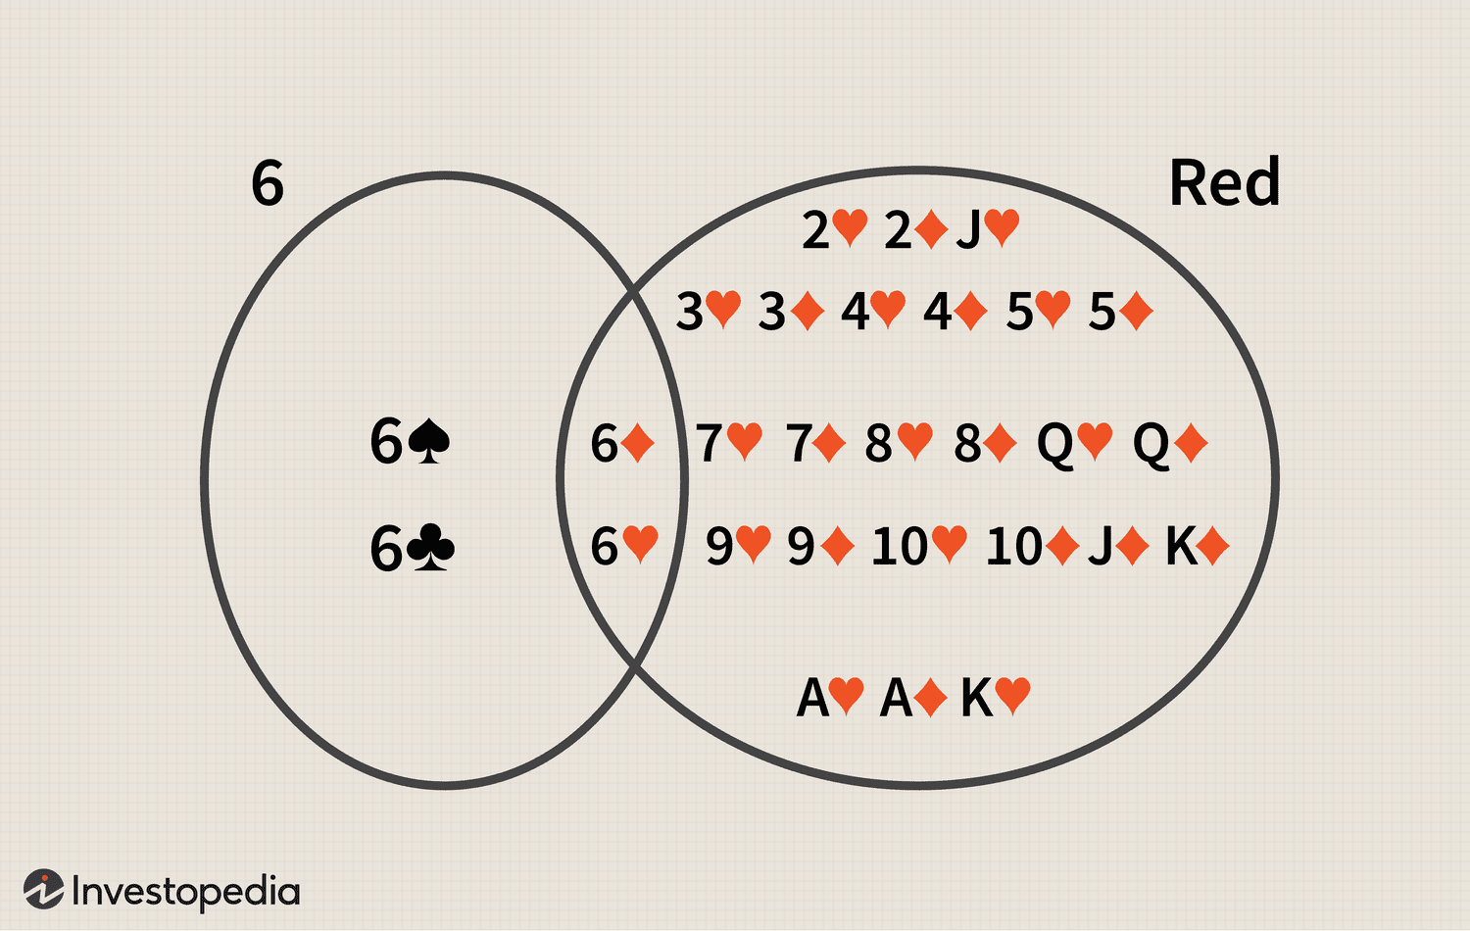


Joint Probability
$$P\left(A∩B\right)=P\left(A\right) ×P(B)$$
$$P\left(6∩Red\right)= ?$$

Slide 8
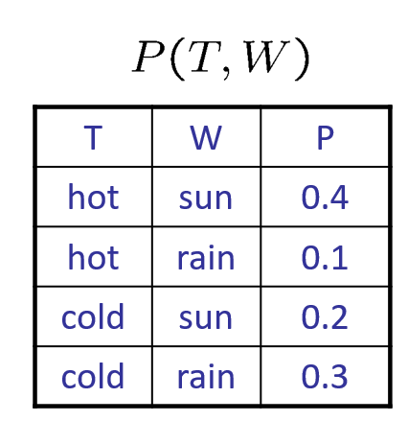

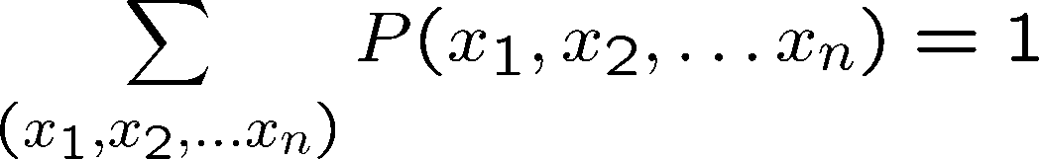
Joint distributions
Joint distribution is the probability of events (variables) happening together.
From a joint distribution, we can calculate the probability of any event
E.g. Probability that it’s hot AND sunny?
Probability that it’s hot?

Slide 9
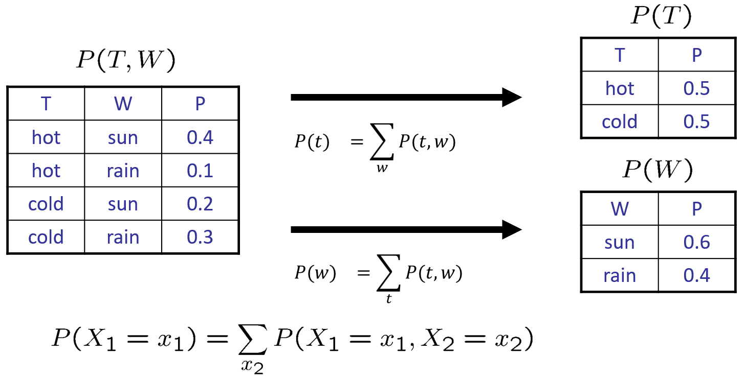
Marginal Distributions
Marginal distributions are sub-tables of joint distribution which eliminate variables

Slide 10
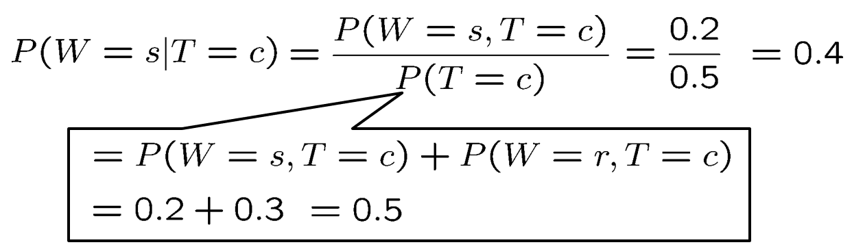

Conditional Probabilities
Conditional probability is the likelihood of an event occurring, based on the occurrence of a previous event.
$$P\left(B|A\right)=P\left(A∩B\right) /P\left(A\right)$$

Slide 11
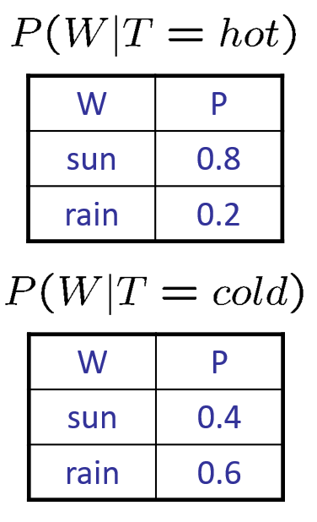
Conditional Distributions
Conditional distributions are probability distributions over some variables given fixed values of others

Slide 12
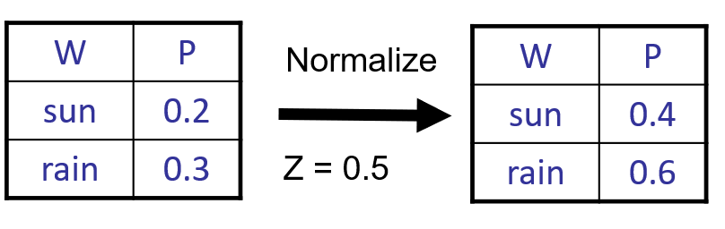
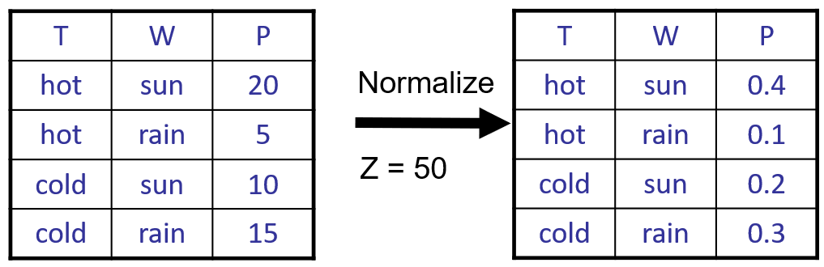
Normalization
Normalization is a process of bringing or restoring probabilities to normal condition → All entries sum to ONE
Procedure:
      Step 1: Computer Z = sum over all entry
      Step 2: Divide every entry by Z

Slide 13
Probabilistic Inference
Probabilistic inference: compute a desired probability from other known probabilities
Generally compute conditional probabilities
P(no accident | light traffic) = 0.90
Probabilities change with new evidence
  P(no accident | light traffic, 5 am) = 0.95
  P(no accident | light traffic, 5 am, raining) = 0.70

Slide 14
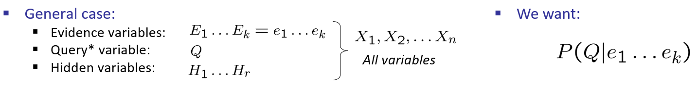
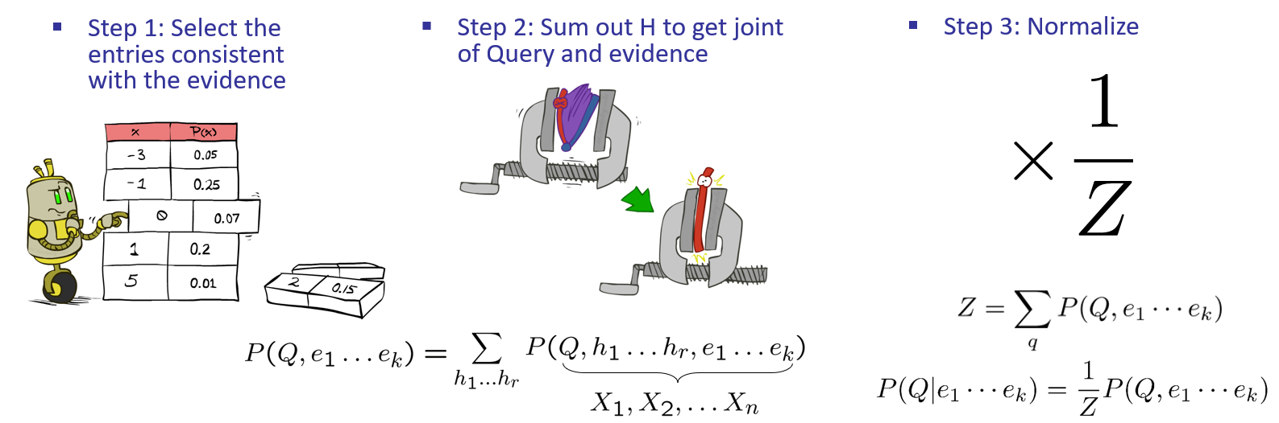
Probabilistic Inference

Slide 15
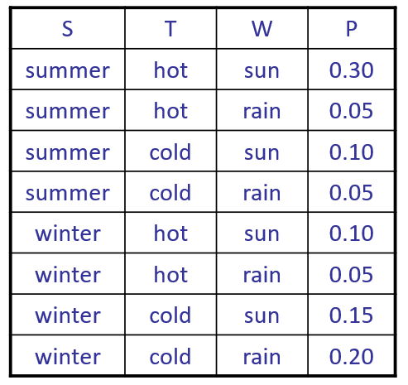
Probabilistic Inference
P(W)?
P(W | winter)?
P(W | winter, hot)?

Slide 16
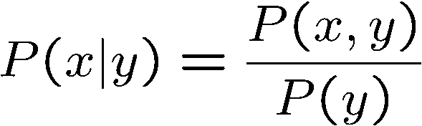

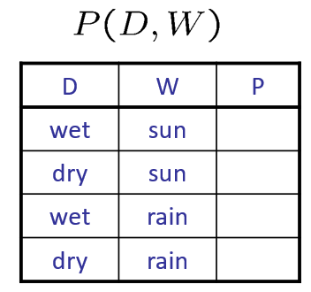
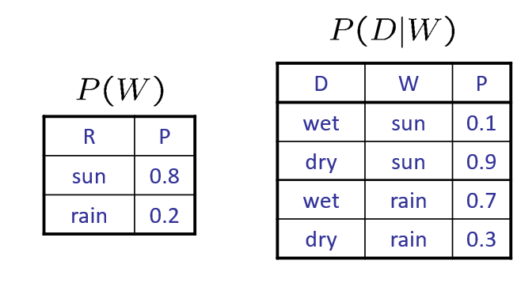
The Product Rule

Slide 17
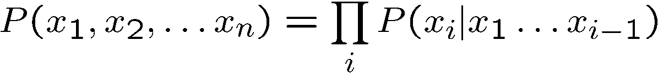
The Chain Rule

Slide 18
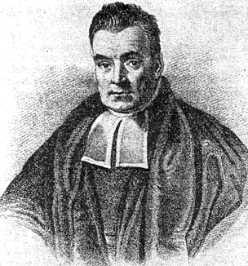

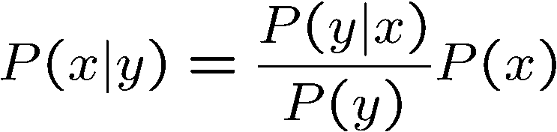
Bayes’ Rule
Therefore:
Bayes’ formular is helpful
Lets us build one conditional from its reverse
Often one conditional is tricky but the other one is simple
Foundation of many advanced systems
Thomas Bayes
(1701 – 1761)

Slide 19
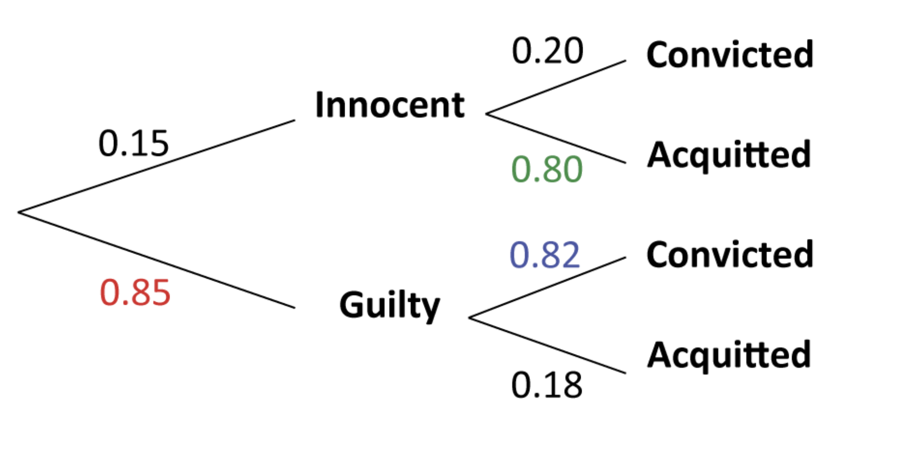

Slide 20
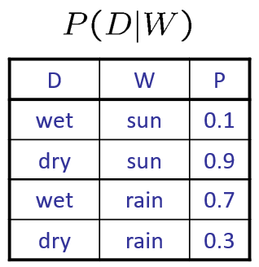
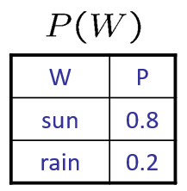
Inference with Bayes’ Rule
Given
What is P(W | dry) ?

Slide 21
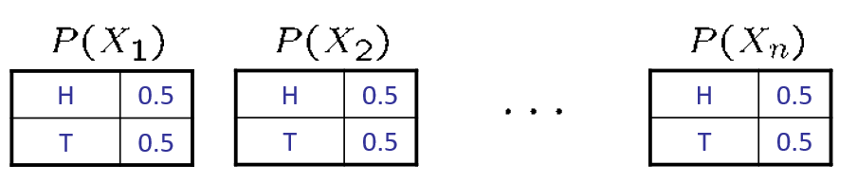
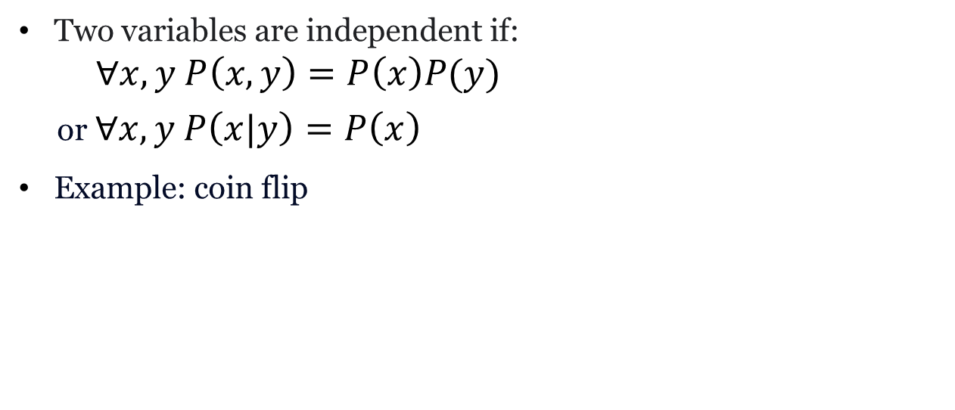
Independence
Two variables are independent if:
$∀x,y P\left(x,y\right)=P\left(x\right)P(y)$
or $∀x,y P\left(x|y\right)=P\left(x\right)$
Example: coin flip

Slide 22
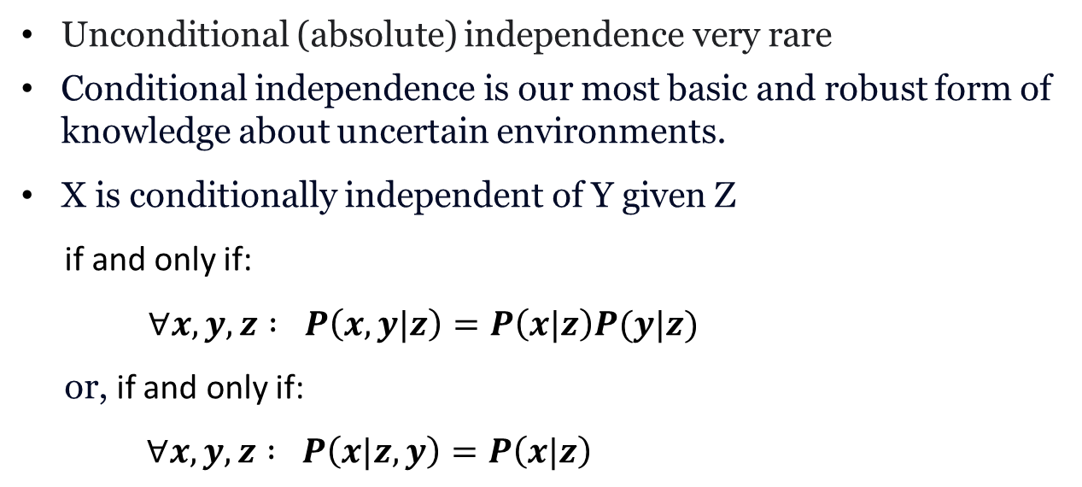
Conditional Independence
Unconditional (absolute) independence very rare
Conditional independence is our most basic and robust form of knowledge about uncertain environments.
X is conditionally independent of Y given Z
if and only if:
$∀x,y,z : P\left(x,y|z\right)=P\left(x|z\right)P(y|z)$
or, if and only if:
$∀x,y,z : P\left(x|z,y\right)=P\left(x|z\right)$

Slide 23
Bayesian Network

Slide 24
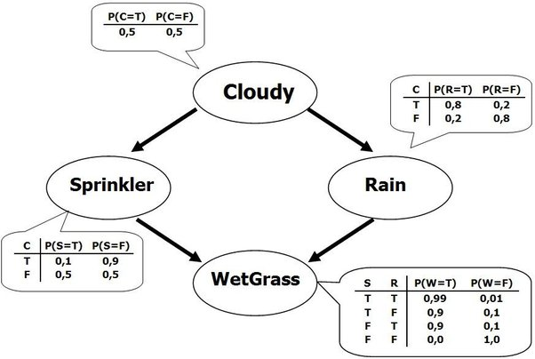
Bayesian Network
Bayes nets: a technique for describing complex joint distributions (models) using simple, local distributions (conditional probabilities)
Bayes Net consists of 2 parts
- Topology (in Directed Acyclic Graph form)
- Local conditional probabilities

Slide 25

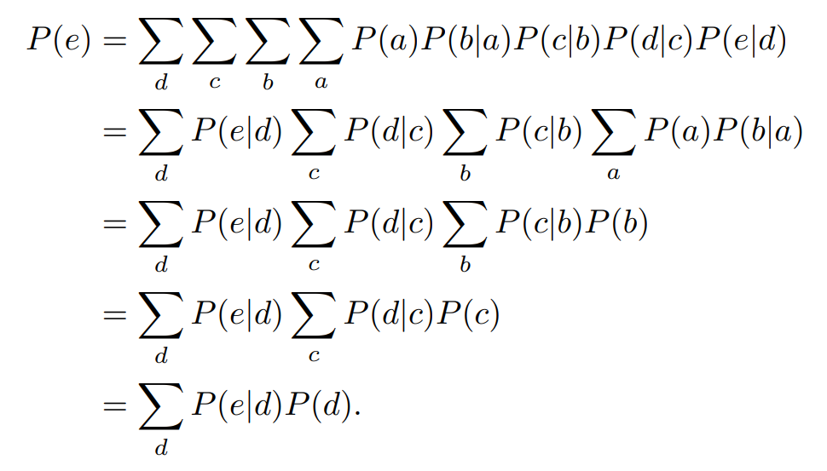
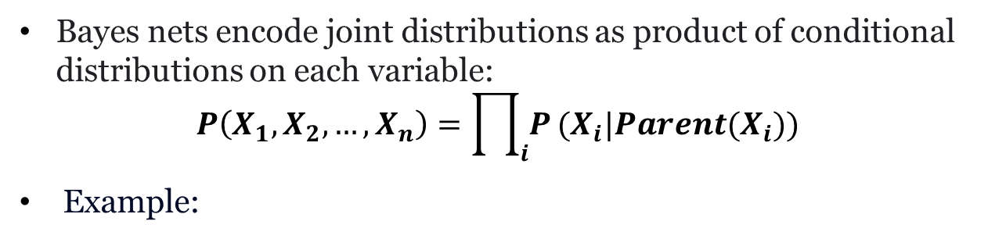
Inference in Bayes Net
Bayes nets encode joint distributions as product of conditional distributions on each variable:
$$P\left(X_{1},X_{2},…,X_{n}\right)=\prod_{i}{P}(X_{i}|Parent(X_{i}))$$
Example:

Slide 26
Bayesian Network
Example: Harry installed a new burglar alarm at his home to detect burglary. The alarm reliably responds at detecting a burglary but also responds for minor earthquakes. Harry has two neighbors John and Mary, who have taken a responsibility to inform Harry at work when they hear the alarm. John always calls Harry when he hears the alarm, but sometimes he got confused with the phone ringing and calls at that time too. On the other hand, Mary likes to listen to high music, so sometimes she misses to hear the alarm.
Problem: Calculate the probability that alarm has sounded, but there is neither a burglary, nor an earthquake occurred, and John and Mary both called the Harry.

Slide 27
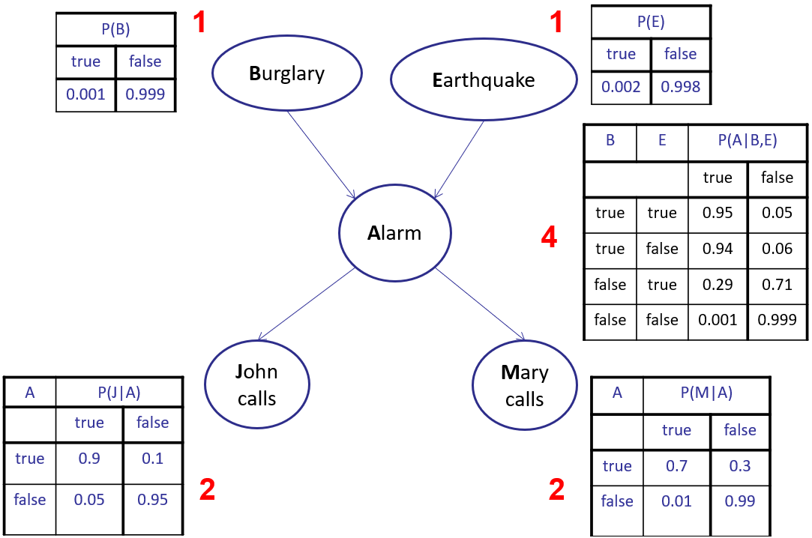
Bayesian Network
$$P\left(J,M,A,!B,!E\right)=P\left(J | A\right)P\left(M | A\right)P\left(A | !B∩!E\right).P\left(!B\right).P(!E)$$

Slide 28
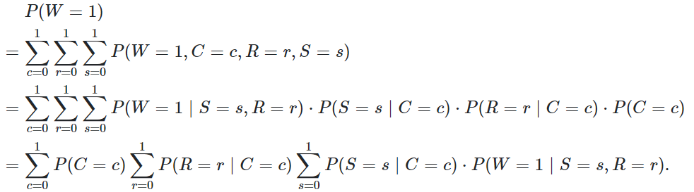

Bayesian Network
$$P\left(S=1 | W=1\right)=?$$

Slide 29
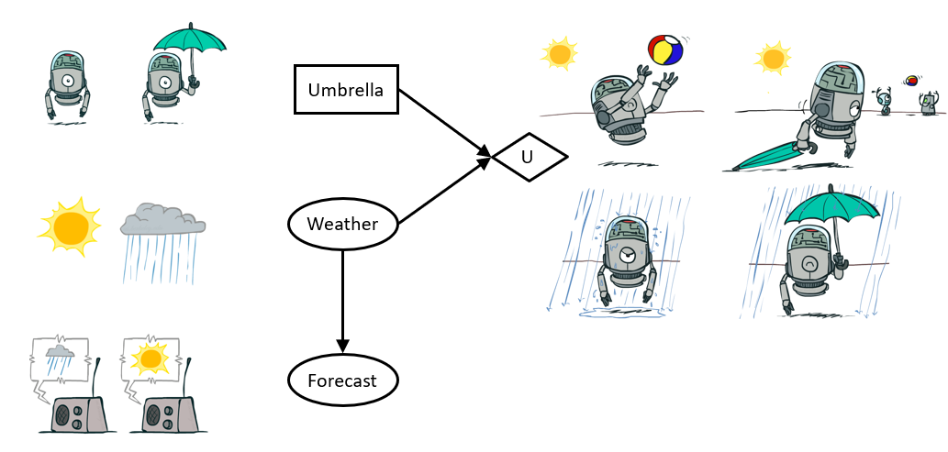
Decision Networks
Action Node
Chance Node
Utility Node
choose the action which maximizes the expected utility given the evidence

Slide 30
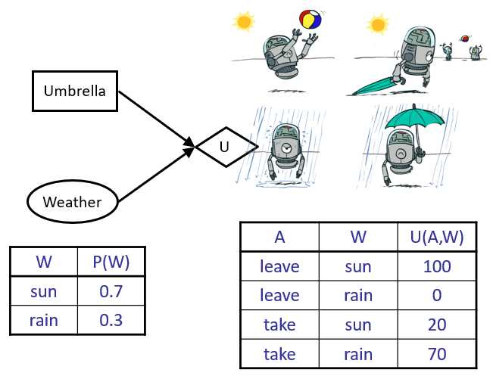
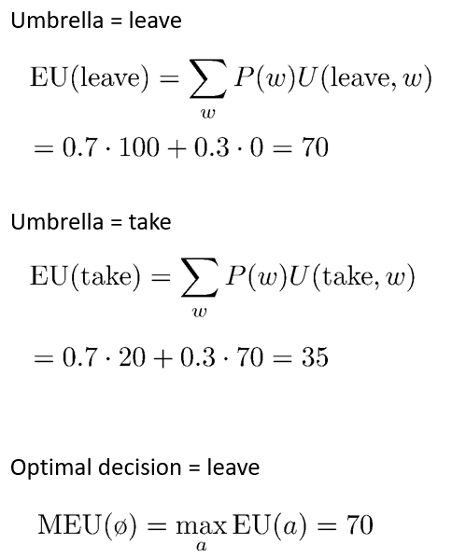
Decision Networks

Slide 31
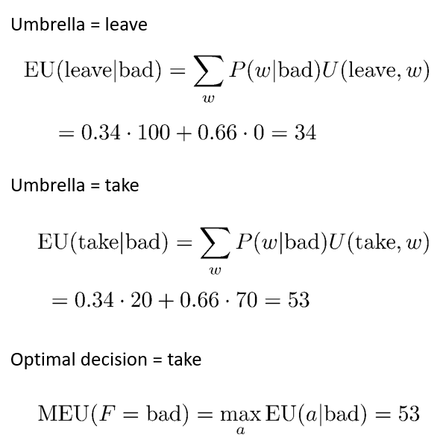
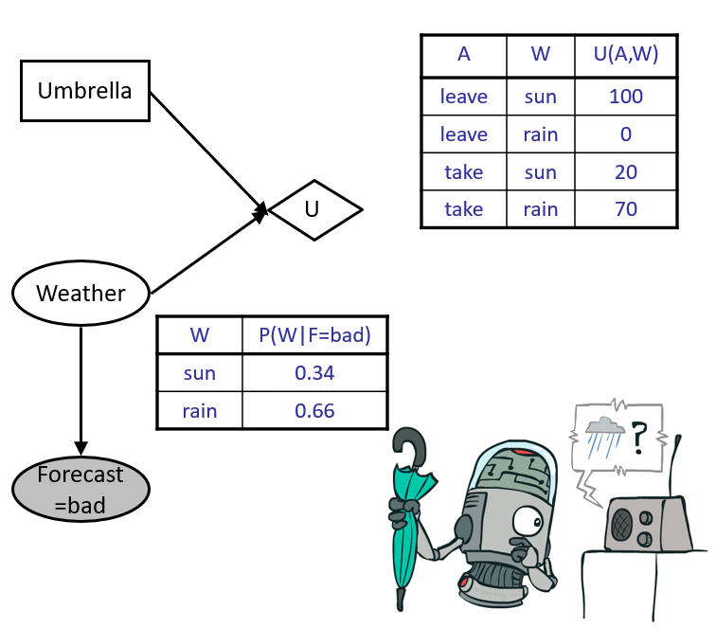
Decision Networks

Slide 32
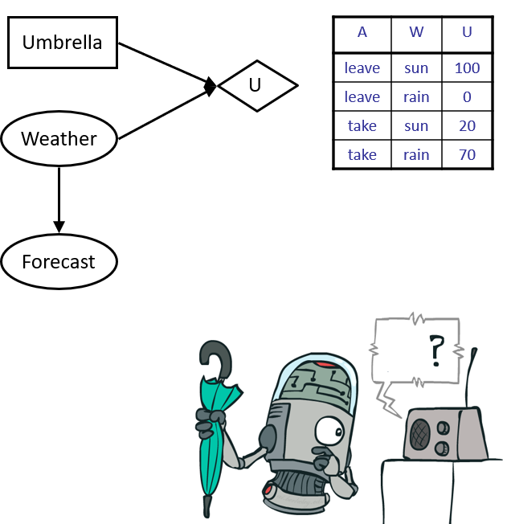
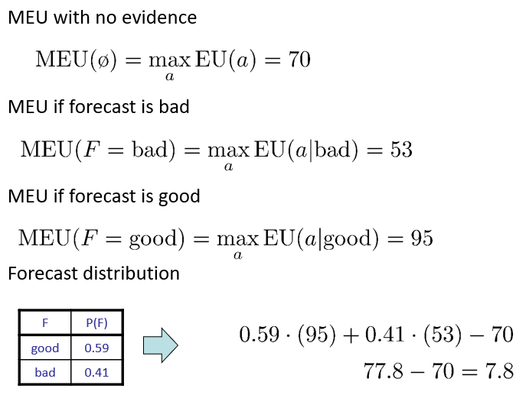
Decision Networks

Slide 33
Naïve Bayes
The Naïve Bayes classifier is a supervised machine learning algorithm, which is used for classification tasks
Procedure:
  - Step 1: convert data into a frequency table
  - Step 2: Create Likelihood table by finding the probability
  - Step 3: Use Bayesian equation to calculate the posterior probability. The class with highest posterior probability is the outcome of the prediction

Slide 34

Naïve Bayes
Example: Spam email detection
Input: an email
Output: spam or normal
Setup:
Get a large collection of example emails, each labeled “spam” or “normal”
Select features:
e.g.: words, text pattern…
Naive Bayes, Clearly Explained!!! - YouTube

Slide 35
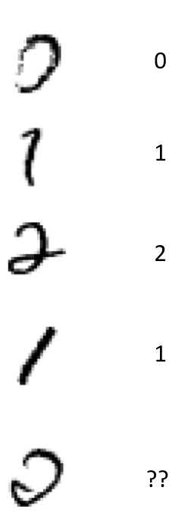
Naïve Bayes
Example: digit recognition
Input: image
Output: a digit 0-9
Setup:
Get a large collection of example images, each labeled with a digit
Select features:
e.g.: pixel value, shape…

Slide 36

Decision Tree

Slide 37
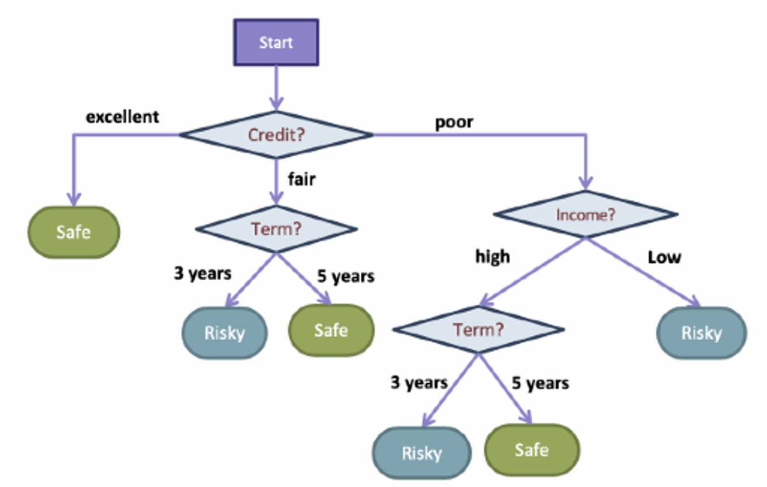
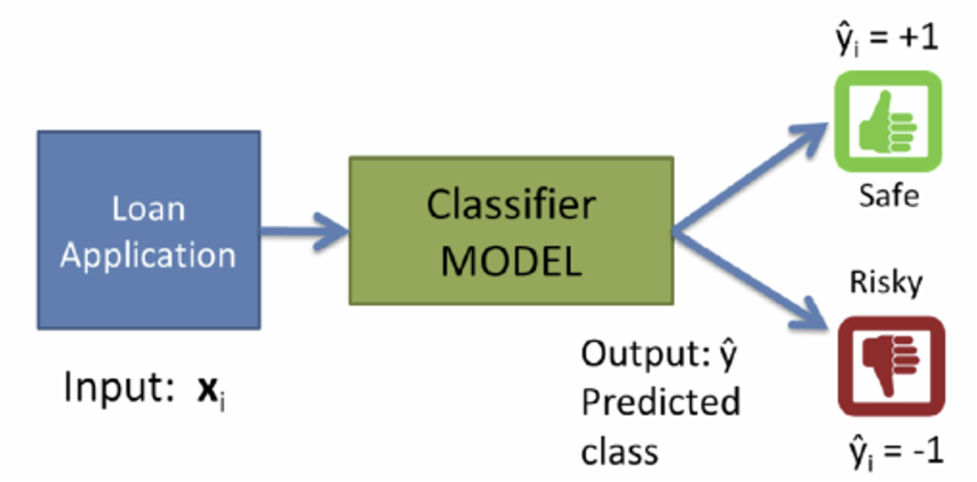
Decision Tree

